Slide 1
SUKUMANI DREAM
What have we done?

Slide 2
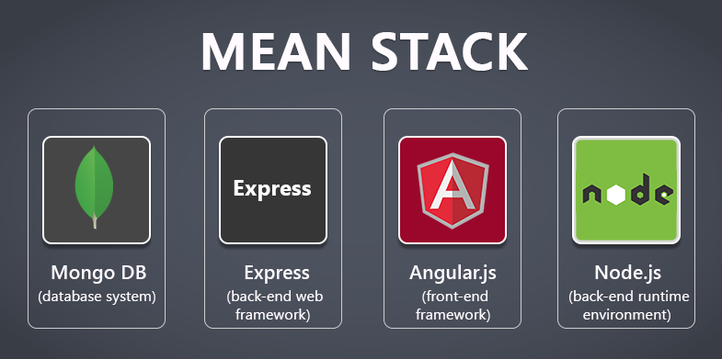
We are going with the MEAN STACK

Slide 3
WHY MEAN?
One framework for all platforms(web, android, iOS).
Easy to go agile.
Flexible.
Quick and easy to develop on.

Slide 4

WHAT WE’VE WORKED ON
Angular Front-end and all back-end business operations (CRUD)
No mongo database yet but already handled in the angular code with an ‘in memory’ database.

Slide 5
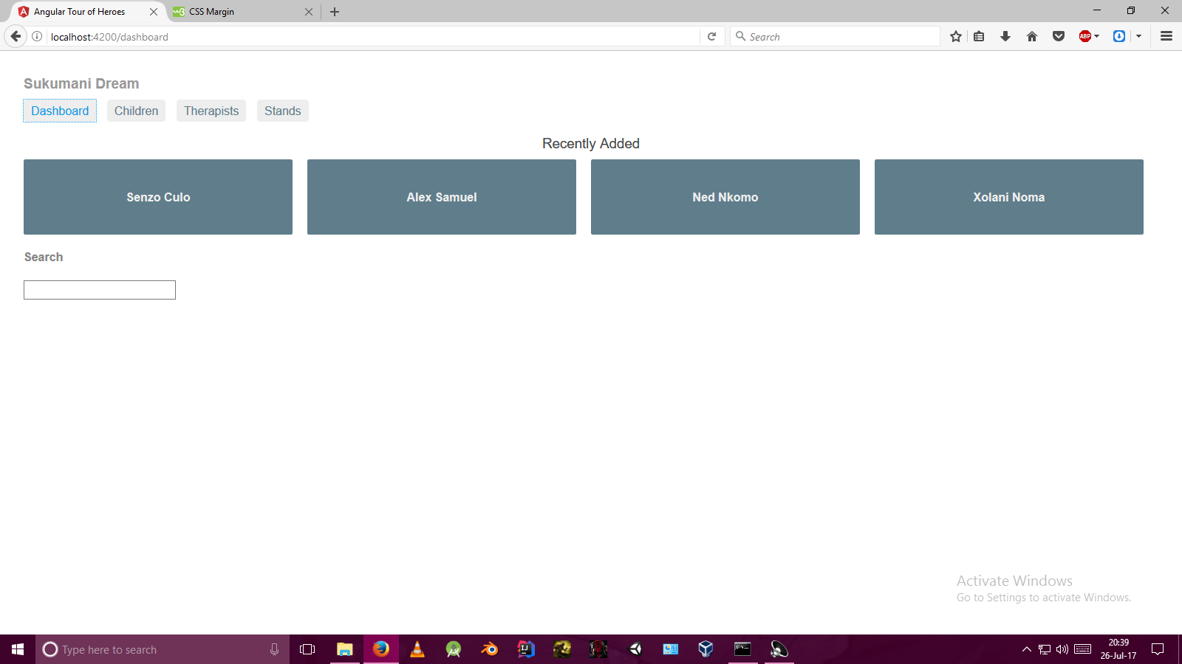

Slide 6
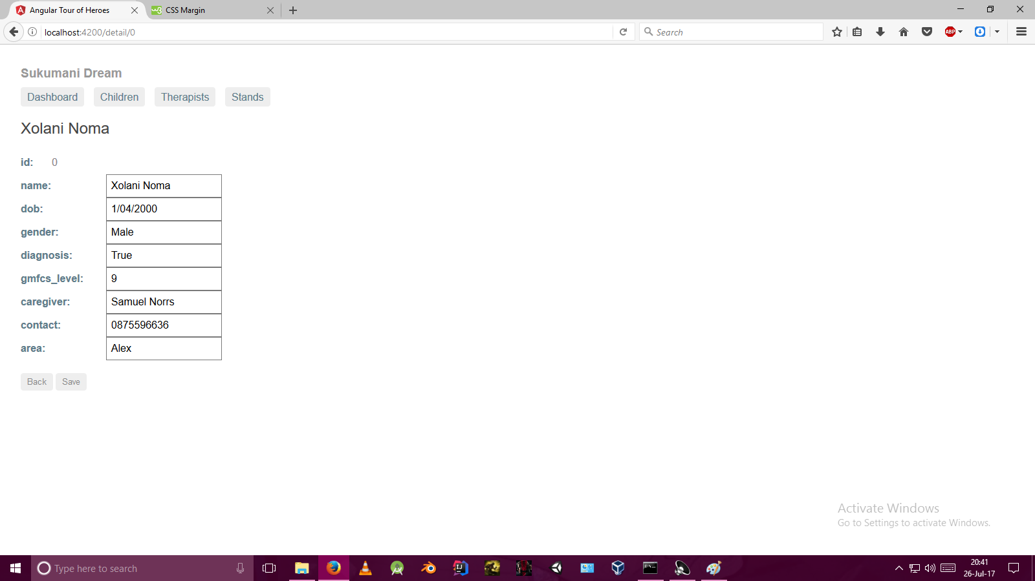

Slide 7
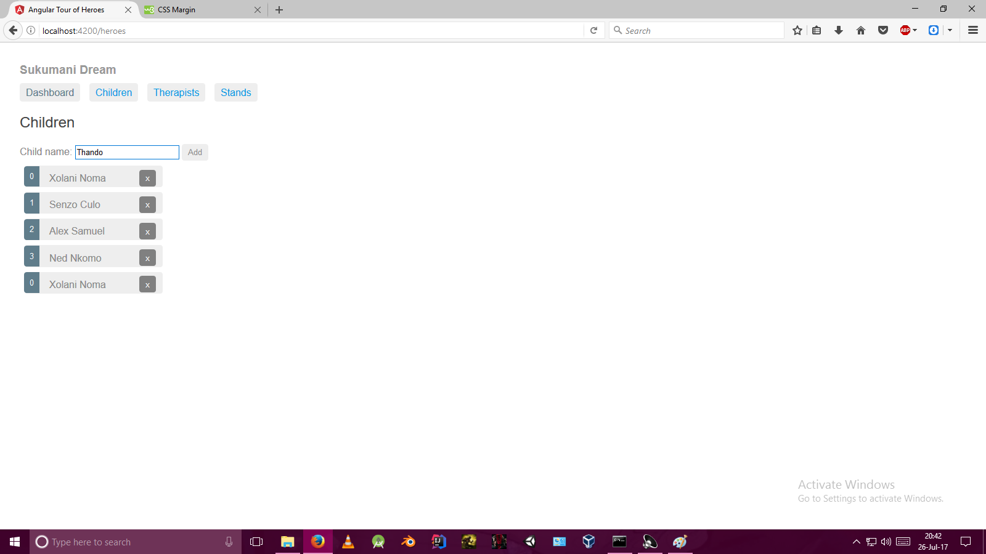

Slide 8
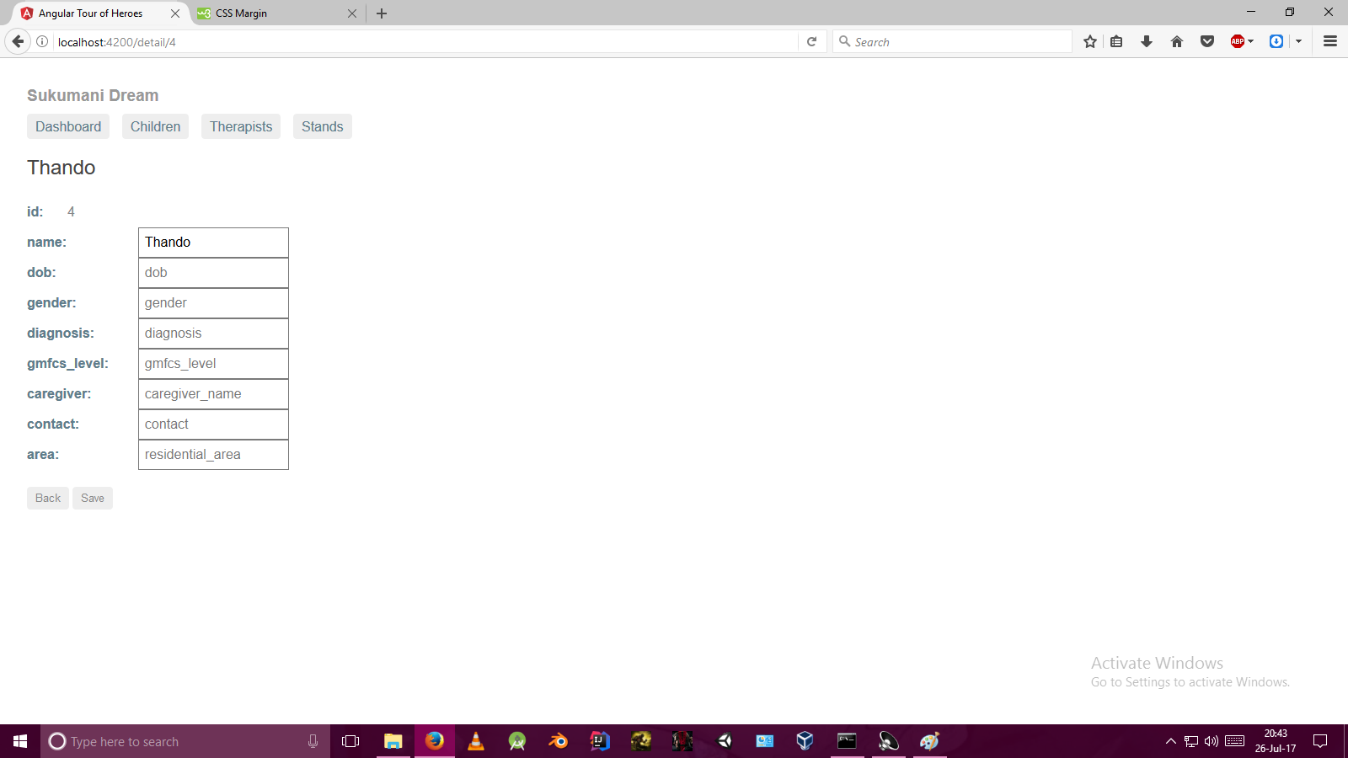

Slide 9
Next steps...
Finish Therapists and Stand tabs.
Work on document uploading.
Login and signup for administrators.

Slide 10
Closing
Thank you for listening.

